Slide 1


Company Profile
Do Not Limit Your Dreams

Slide 2
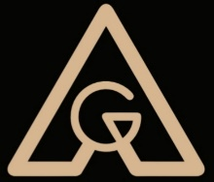









Group Companies
Do Not Limit Your Dreams

Slide 3
Agenda
* Alternative Group ID
* Vision & Mission
* Business Structure
* Group Companies & Solutions
Do Not Limit Your Dreams

Slide 4
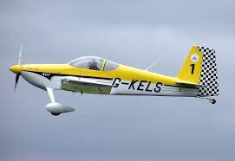
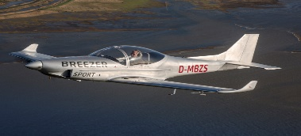
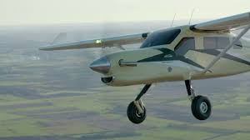
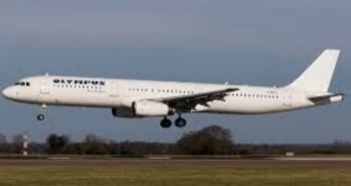
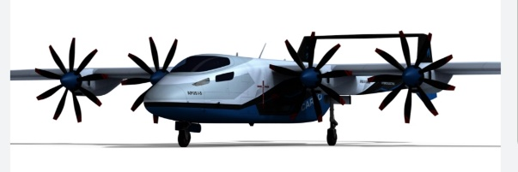
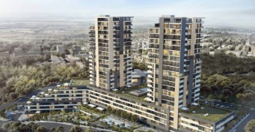
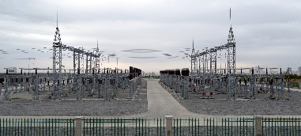
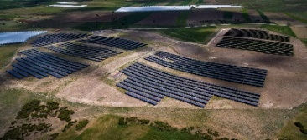
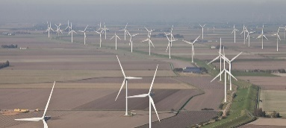
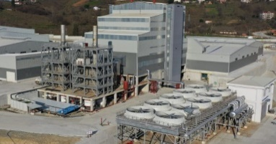
ID
* Alternatif Group is a group of companies providing manufacturing, investment, procurement, consulting and complex program management in energy power, aviation, construction, agriculture, defence and security sectors, and accredited and supported by the related state institutions of German and Turkish Governments.
Do Not Limit Your Dreams

Slide 5

Vision
* Experienced, Effective, Enduring Solutions
Do Not Limit Your Dreams

Slide 6
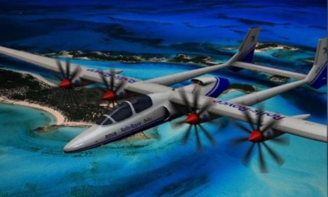

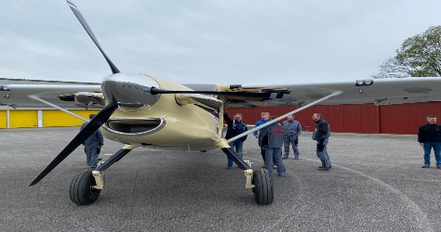
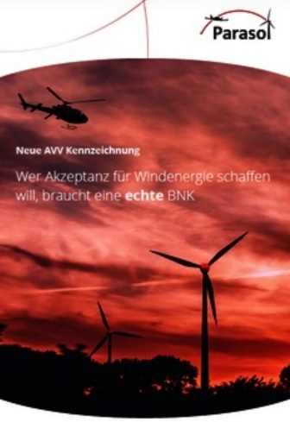
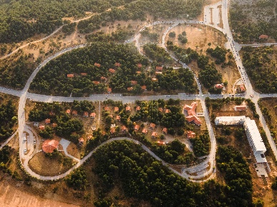
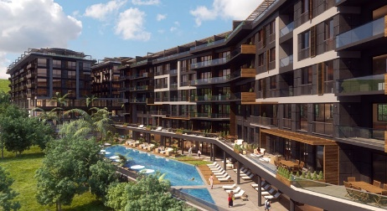
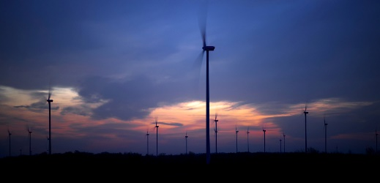
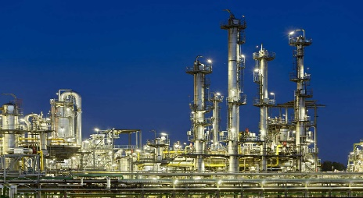
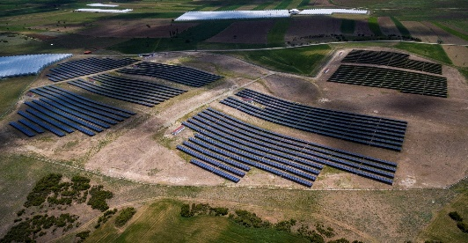
Mission
* To provide high quality of products and services to our customers by increasing the competetiveness in the sectors that we operate.
Do Not Limit Your Dreams

Slide 7
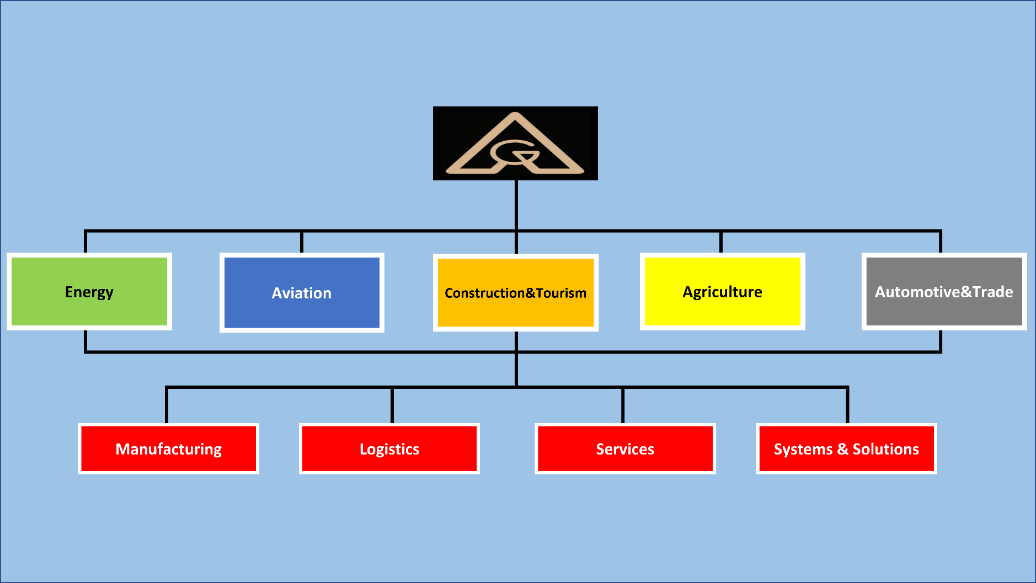
Business Structure
Do Not Limit Your Dreams

Slide 8

Energy
Do Not Limit Your Dreams

Slide 9
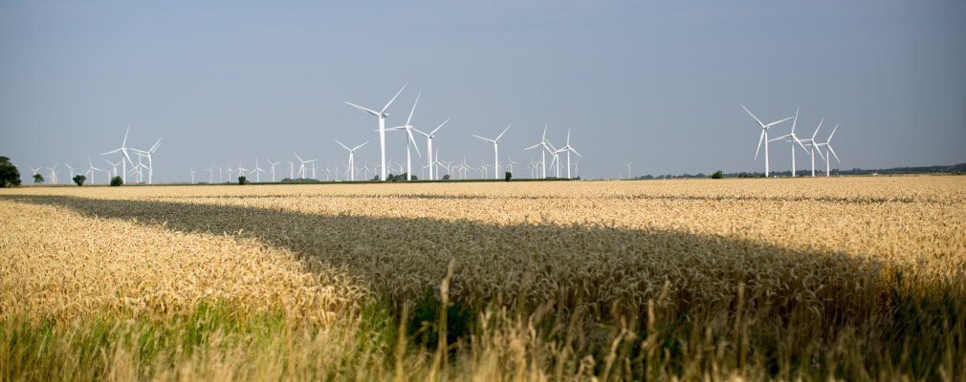
Group Companies & Solutions
* German Expertise in wind energy – since 1989.
* Based in Reußenkögen in Northern Germany.
* Alternatif Group is one of the most recognized service providers for wind energy.
* We are the co-founders of community energy parks.
* We have wind parks in Turkey, France, Reußenköge, Jalm, Wöhrden, Mannhagen, Hohen Pritz, Waldow, Lamstedt, and Blye.

Slide 10
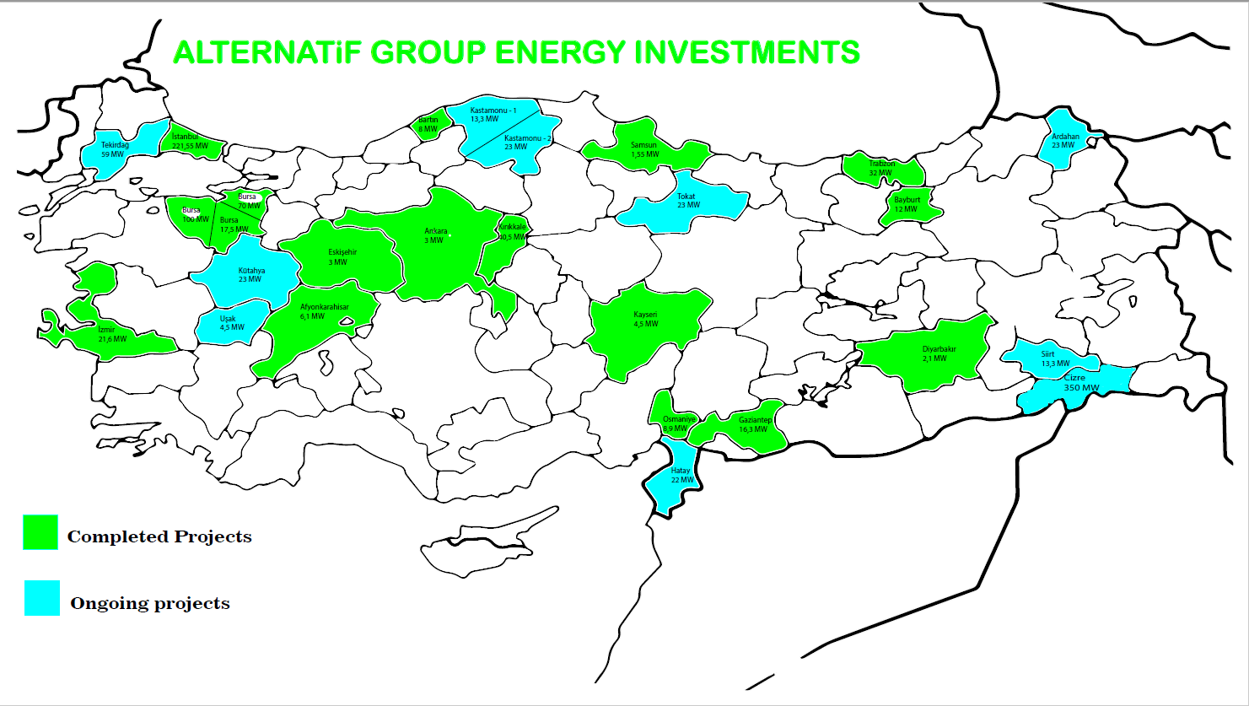
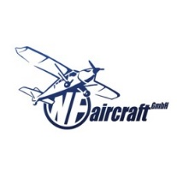

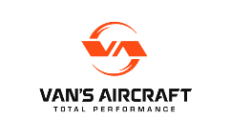




Group Companies & Solutions
Do Not Limit Your Dreams

Slide 11
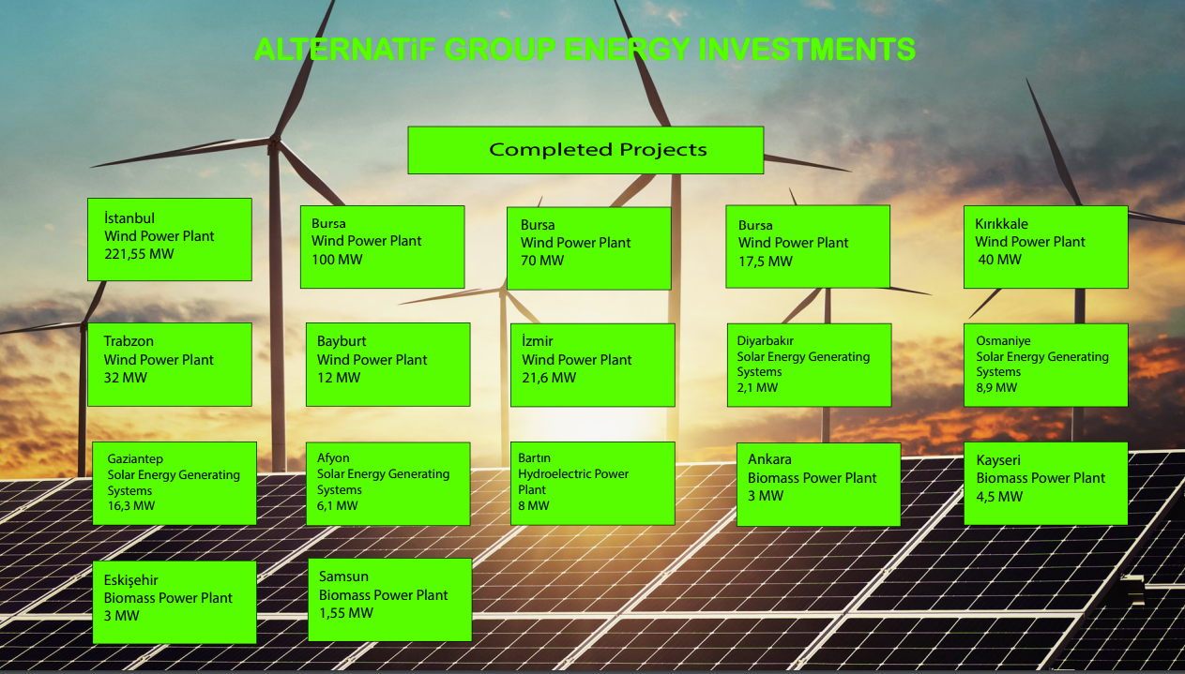
Group Companies & Solutions
Do Not Limit Your Dreams

Slide 12
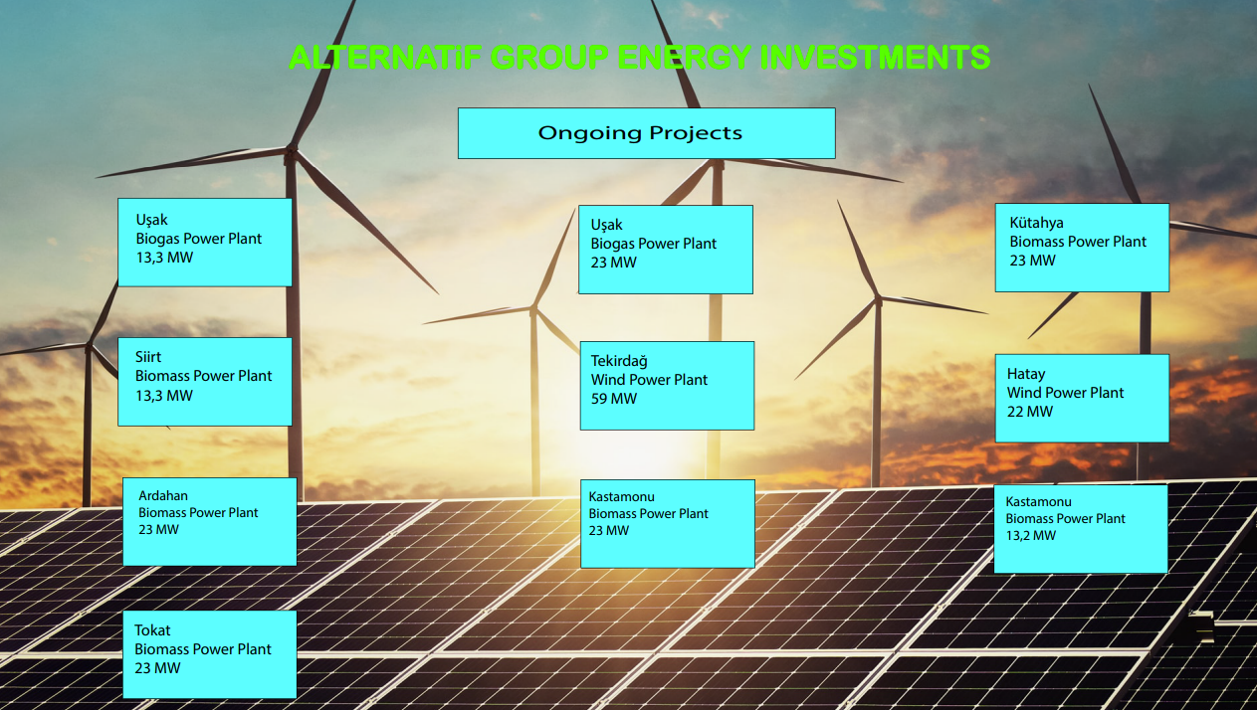
Group Companies & Solutions
Do Not Limit Your Dreams

Slide 13
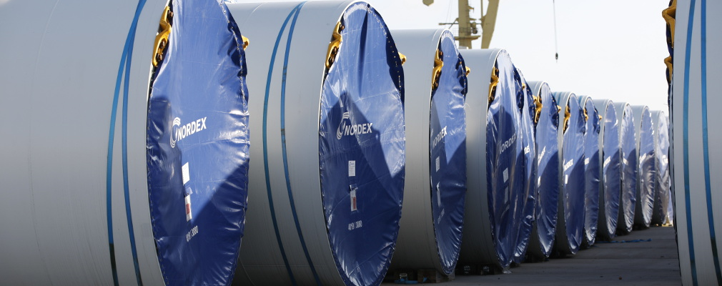
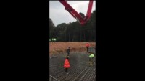
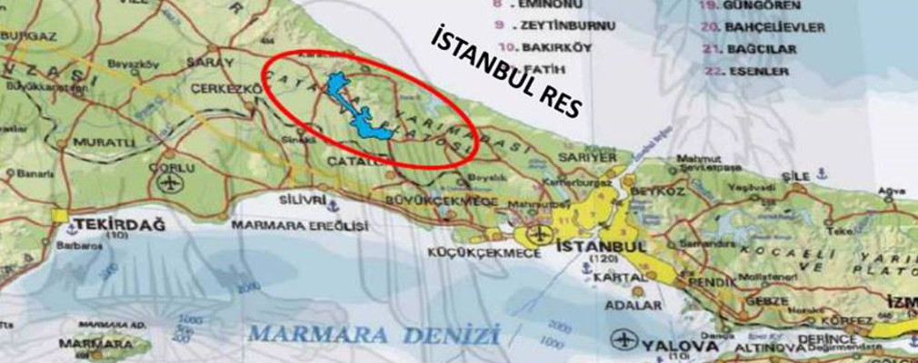
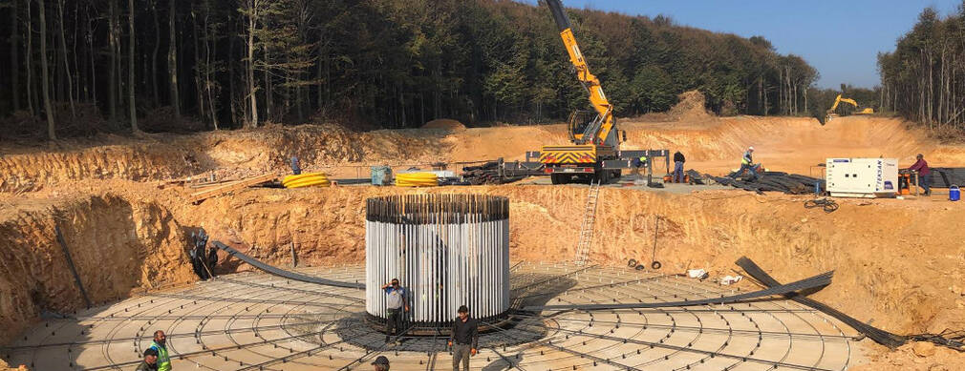
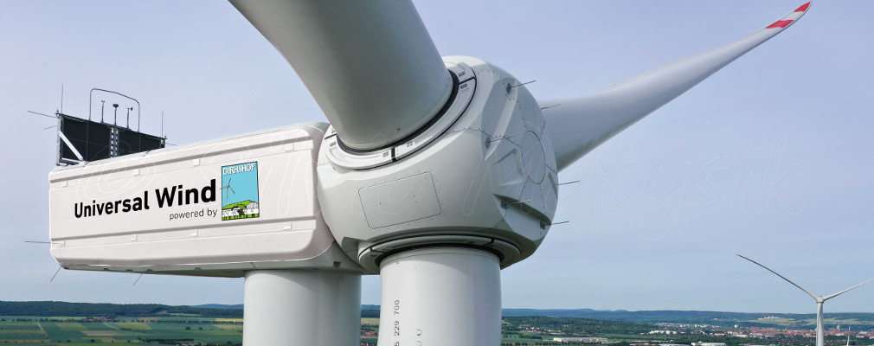
UNIWERSAL WIND
Do Not Limit Your Dreams

Slide 14
Group Companies & Solutions
(Energy Production Licence)
Do Not Limit Your Dreams

Slide 15
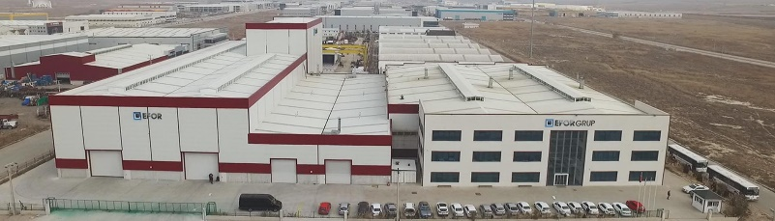
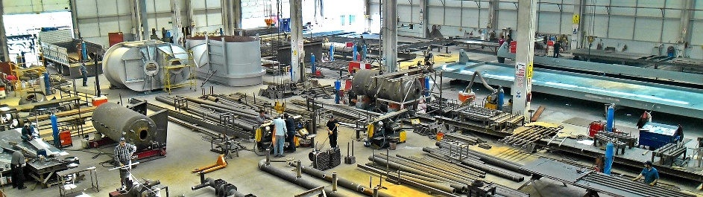
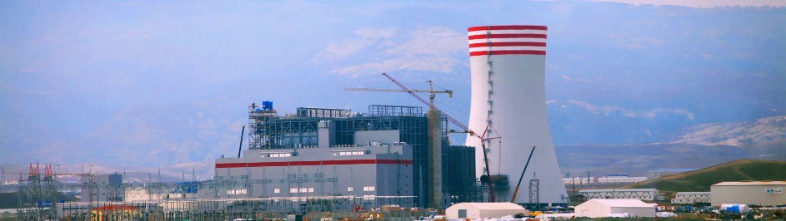
Group Companies & Solutions
* EFOR Industrial Plants Installation, Manufacture and Construction Inc. was founded in Ankara in 1998.
* Providing thermal, natural gas and hydroelectric power plants and large industrial installations.
* Fast, cheap, high quality and satisfactory manufacturing, complete installation, disassembly, engineering and commissioning services about pressurised and non-pressurised units, steel construction, construction and rehabilitation activities.
* Efor Inc. continues its operations in 5 manufacturing plant in 3 different locations around Ankara.
Do Not Limit Your Dreams

Slide 16
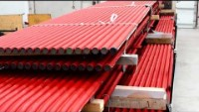
Group Companies & Solutions
Do Not Limit Your Dreams

Slide 17
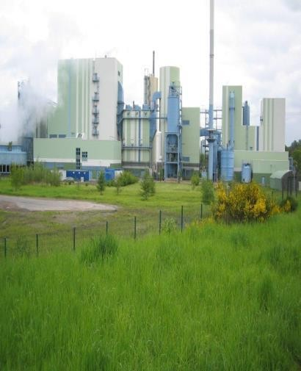
Group Companies & Solutions
(WtE References)
Plant Type | FB Incineration
Fuel | Municipal Sludge + Coal + Other Municipal Waste
Capacity | 15 t/h Solid
Incineration Norms | EU Norms (EU Dir. 2000/76)
Steam Paramaters | 40 bar 400 °C superheated
Steam Cap | 41 t/h
Flue Gas Treatment | Electrostatic Precip., Flue Gas Treatment System
Flue Gas Amount | 93’000 Nm3/h
Germany
Do Not Limit Your Dreams

Slide 18
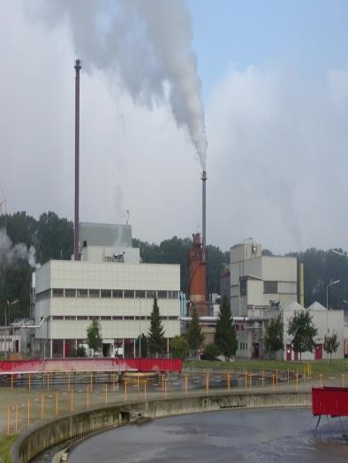
Group Companies & Solutions
(WtE References)
Germany
Plant Type | FB Incineration
Fuel | Municipal Sludge
Capacity | 2 t/h Solid/Each line
Incineration Norms | EU Norms (EU Dir. 2000/76)
Steam Paramaters | 40 bar 400 °C superheated
Steam Cap | 7 t/h / each line
Flue Gas Treatment | Electrostatic Precip., Flue Gas Treatment System
Flue Gas Amount | 18’000 Nm3/h
Do Not Limit Your Dreams

Slide 19
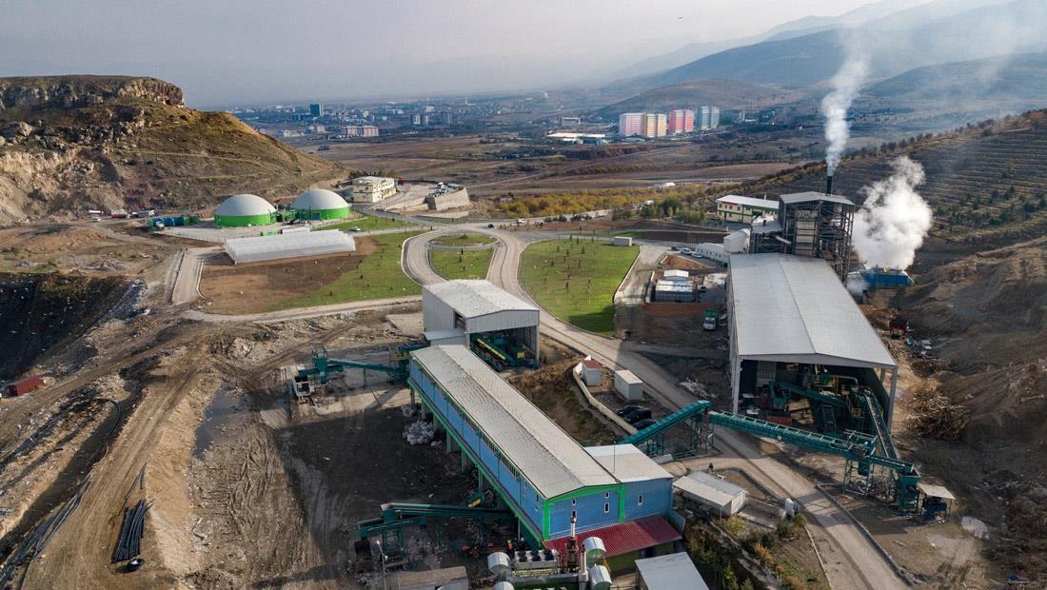
Group Companies & Solutions
(WtE References)
Site A WTE Power Plant (Central Anatolia/Turkey)
Start date of plant: January, 2014
Capacity: 4,8 MWe
Gas Engines: 4 X 1.200 kW/h
Boosters: 3 X 1500 m3
Biogas Plant: 2 X 3.500 m3
Sorting Plant Capacity: 400 ton/day
RDF Capacity: 80 ton/day
Energy Generation, Field Management, Mechanical Separation, RDF Preparation, Biomethanisation, Transfer Station Operation, Waste Transportation
Annual Turnover: 6 M USD (approximately)
Do Not Limit Your Dreams

Slide 20
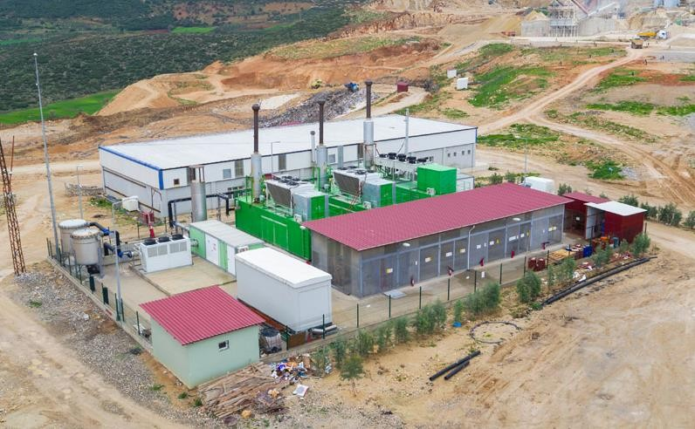
Group Companies & Solutions
(WtE References)
Site C WTE Power Plant (South Anatolia/Turkey)
Start date of plant: November 2015
Capacity: 4,3 Mwe
Gas Engines: 3 x 1.413kW/h
Boosters: 2 x 750m3
Energy generation
Annual Turnover: 4 M USD (approximately)
Do Not Limit Your Dreams

Slide 21
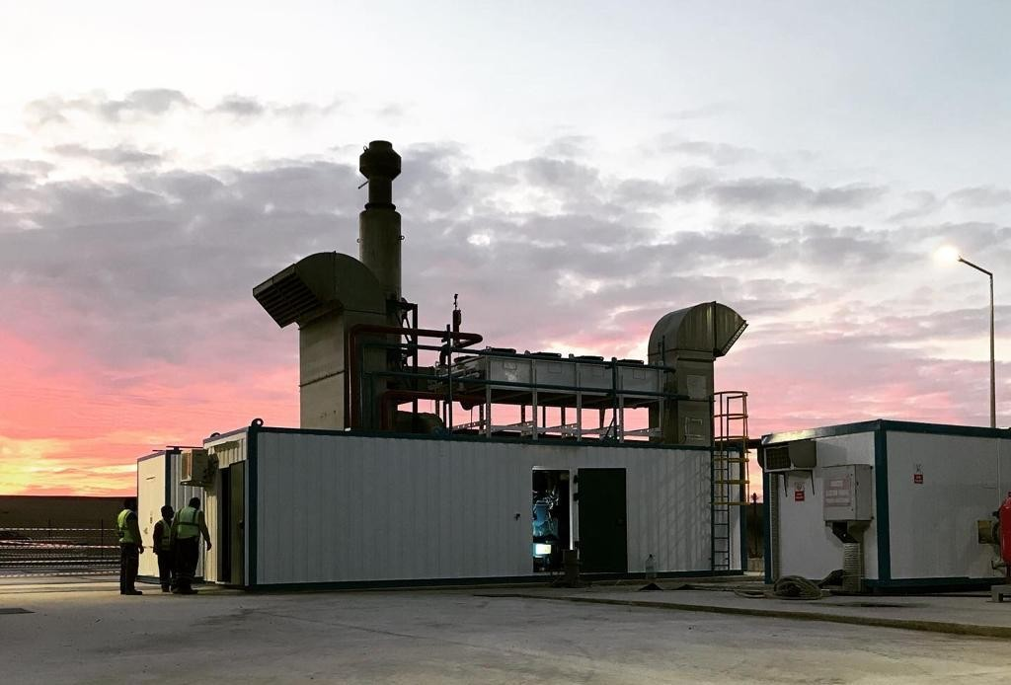
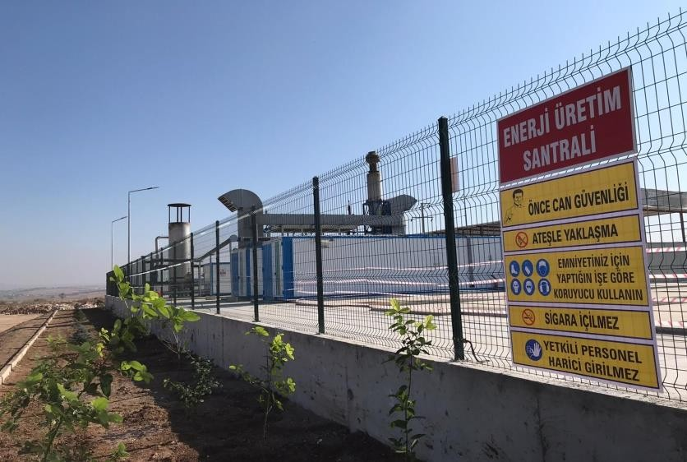
Group Companies & Solutions
(WtE References)
Site G WTE Power Plant (Central Anatolia/Turkey)
Start date of plant: October, 2019
Capacity: 6 MWe
  Phase 1: 2,4 MWe
Gas Engines: 5 x 1.200 kW/h
Boosters: 2 x 750 m3
Energy Generation, Field Management, Mechanical Separation, RDF Preparation, Biomethanization, Transfer Station Construction
Annual Turnover: 2,4 M USD – Phase I (apprx)
5,5 M USD – All (approximately)
Do Not Limit Your Dreams

Slide 22
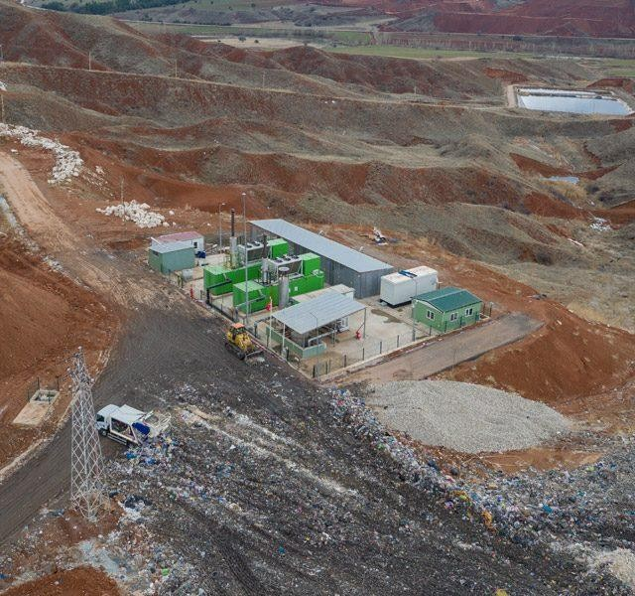
Group Companies & Solutions
(WtE References)
Site B WTE Power Plant (Central Anatolia/Turkey)
Start date of plant: October, 2015
Capacity: 2,8 MWe
Gas Engines: 1413 + 1067 kW/h
Boosters: 2 x 1500 m3
Sorting Plant Capacity: 300 Ton/Day
Energy Production, Field Management, Mecha Separation
Annual Turnover: 3 M USD (approximately)
Do Not Limit Your Dreams

Slide 23
Aviation
Do Not Limit Your Dreams

Slide 24
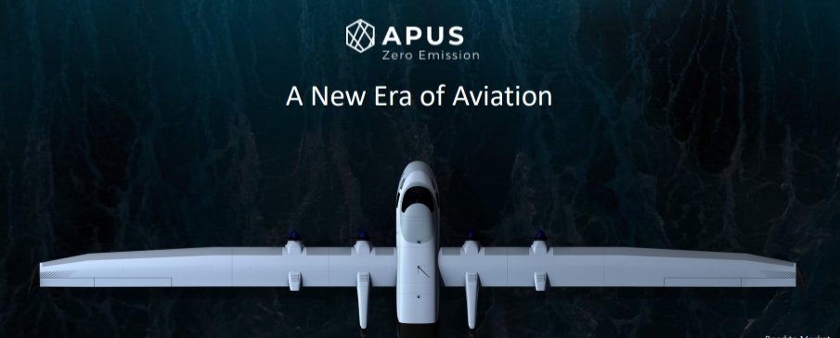
Group Companies & Solutions
* APUS Zero Emission’s mission is to develop and market hydrogen electric aircrafts and powertrains to conquer one of the biggest challenges of society – environmental pollution.
* Pioneering the subject matter, strong partners such as Rolls Royce, Fraunhofer Institute, Powercell and Heggemann supported APUS Zero Emission already early on.
* While the initial milestone will be the first zero emission flights of the APUS i-2 and i-5 aircrafts in 2023, commercial offering and launch of production will start from 2027 on.
* Europe’s first pure hydrogen electric aircraft and powertrain OEM.
* Ongoing negotiation with BIA for factory location in Bulgaria.
Do Not Limit Your Dreams

Slide 25
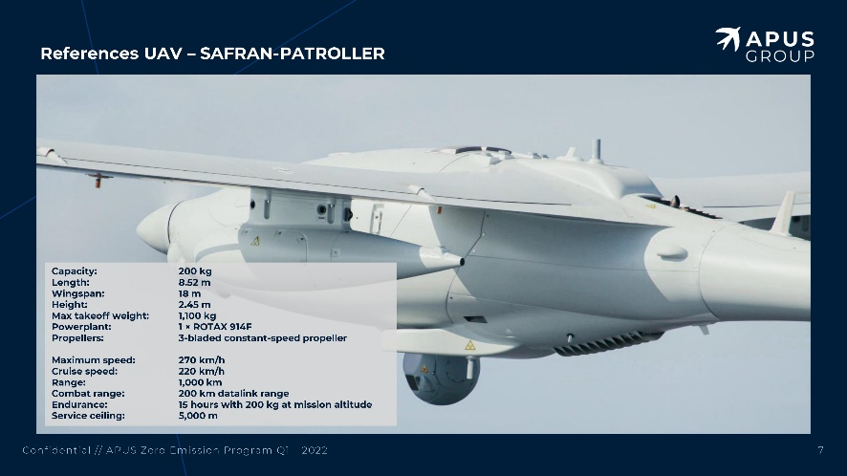
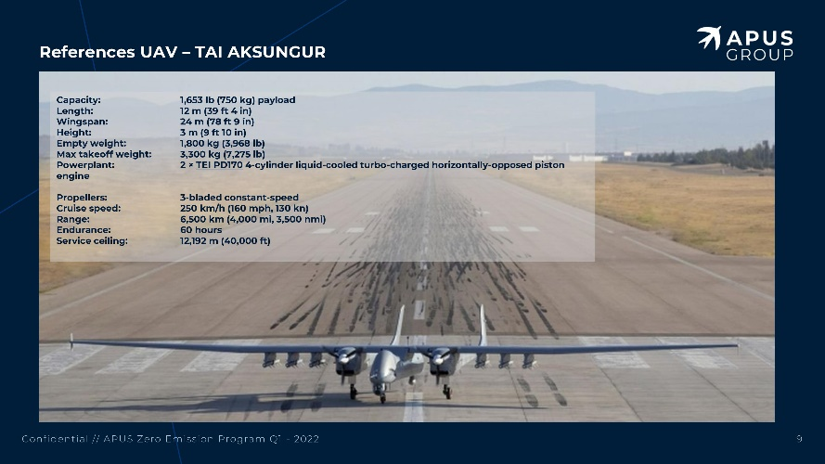
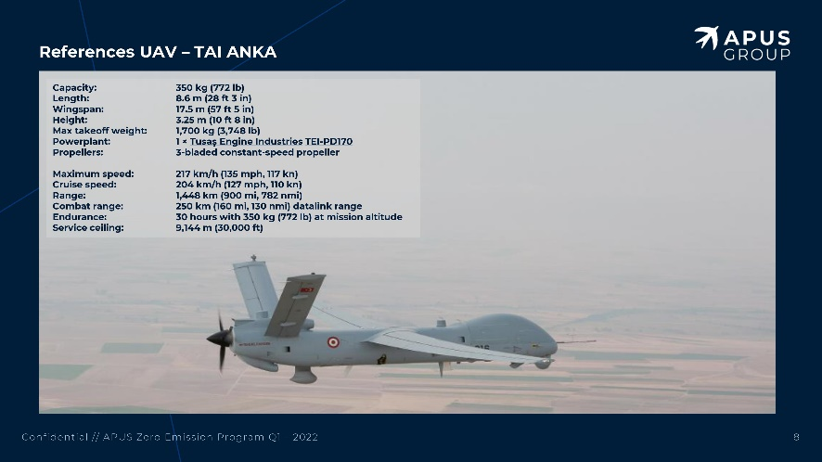
Group Companies & Solutions
Do Not Limit Your Dreams

Slide 26
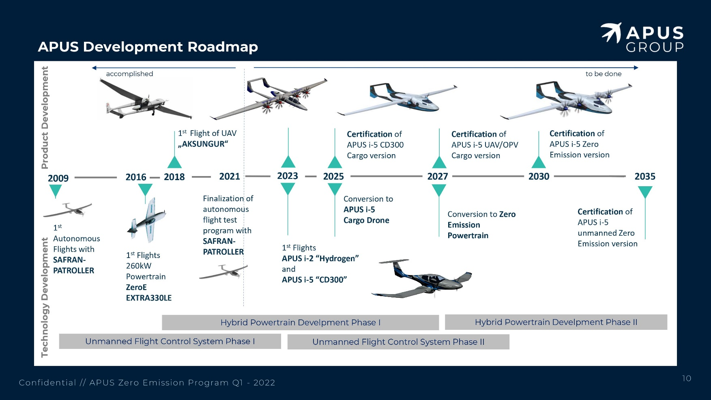
Group Companies & Solutions
Do Not Limit Your Dreams

Slide 27
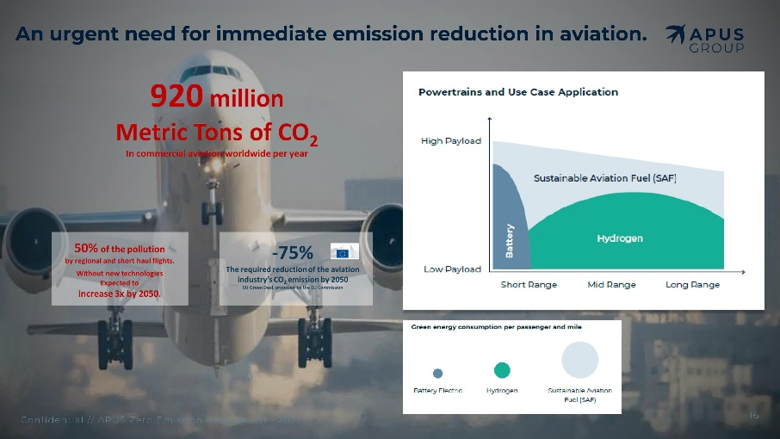
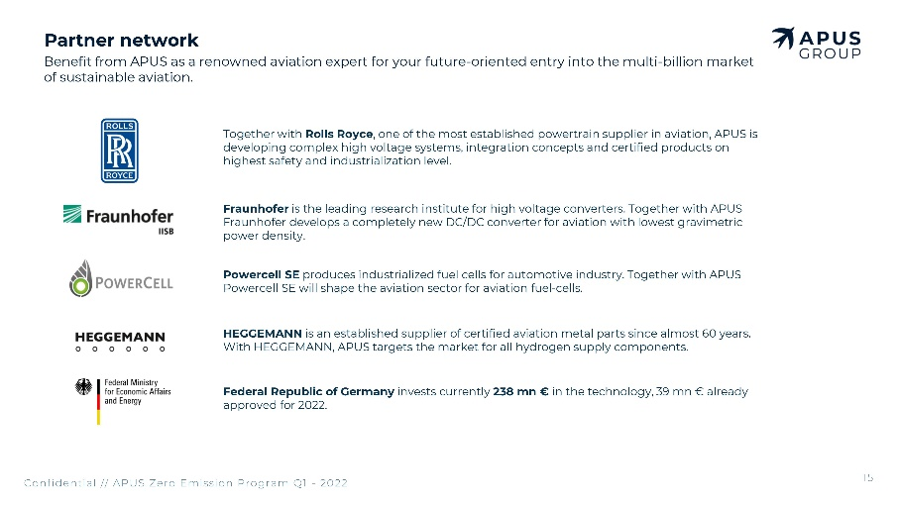
Group Companies & Solutions
Do Not Limit Your Dreams

Slide 28
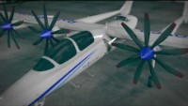
Group Companies & Solutions
Do Not Limit Your Dreams

Slide 29

Group Companies & Solutions
* Founded in 2018.
* NF-Aircraft GmbH is located in Germany.
* The project and company was immediately recognized by the local industry development age
* Gained FAA Special Airworthiness Certificate in 2019.
* EASA Certification procedures are ongoing.
https://www.youtube.com/watch?v=jtangtv1nXU

Slide 30



Group Companies & Solutions
* Air Taxi solutions in Turkey and all over the world.
Do Not Limit Your Dreams

Slide 31

Group Companies & Solutions
* Established in 2015.
* Has its premises in Attica, Greece.
* Olympus is an EASA approved carrier.
* Operating 3 freighter and one passenger aircrafts, and is in process to receive one additional freighter aircraft.
Do Not Limit Your Dreams

Slide 32


Group Companies & Solutions
* Based in Sofia, Bulgaria.
* Serves as VIP flights broker.
Do Not Limit Your Dreams

Slide 33





Group Companies & Solutions
Do Not Limit Your Dreams

Slide 34
Construction & Tourism
Do Not Limit Your Dreams

Slide 35


Group Companies & Solutions
* CABA Inc. was established in1998 in the city of Diyarbakır, Türkiye.
* The company has flourished with rapid business advancement in commercial projects in areas of energy, tourism, mining, fuel oil, logistics and real estate investment projects.
* CABA continues to directly impact social life and social structure.
Do Not Limit Your Dreams

Slide 36


Group Companies & Solutions
Do Not Limit Your Dreams

Slide 37


Group Companies & Solutions
Do Not Limit Your Dreams

Slide 38


Group Companies & Solutions
Do Not Limit Your Dreams

Slide 39


Group Companies & Solutions
Do Not Limit Your Dreams

Slide 40


Group Companies & Solutions
Do Not Limit Your Dreams

Slide 41



Group Companies & Solutions
* Renewable Energy Systems
* Cogeneration
* Trigeneration
Do Not Limit Your Dreams

Slide 42


Group Companies & Solutions
Do Not Limit Your Dreams

Slide 43


Group Companies & Solutions
Do Not Limit Your Dreams

Slide 44


Group Companies & Solutions
Do Not Limit Your Dreams

Slide 45


Group Companies & Solutions
Do Not Limit Your Dreams

Slide 46


Group Companies & Solutions
Do Not Limit Your Dreams

Slide 47


Group Companies & Solutions
Do Not Limit Your Dreams

Slide 48


Group Companies & Solutions
Do Not Limit Your Dreams

Slide 49
Agriculture
Do Not Limit Your Dreams

Slide 50



Group Companies & Solutions
* As Bioeffektory Fertilizer, we continue to serve you, our valuable farmers, with powder/liquid fertilizers and soil conditioners, with the knowledge of years that have achieved all success in agricultural lands at home and abroad.
* We offer our products from Antalya to all over Turkey and the world.
Do Not Limit Your Dreams

Slide 51











Group Companies & Solutions
(Agricultural Products)
Do Not Limit Your Dreams

Slide 52




Group Companies & Solutions
(Soya Factory)
* We deal with processing soyabean seeds, refining oil for edible use and soya based value added products.
* Our wide product range is manufactured at ISO:9001:2015 certified production facilities.
* Our facilities ensure proper production and packaging of products in the most hygienic and conducive conditions.
Do Not Limit Your Dreams

Slide 53


Group Companies & Solutions
(Soya Factory)
Do Not Limit Your Dreams

Slide 54

Industrial Hemp Production
Do Not Limit Your Dreams

Slide 55

Industrial Hemp Production
Do Not Limit Your Dreams

Slide 56

Group Companies & Solutions
Do Not Limit Your Dreams

Slide 57

Do Not Limit Your Dreams

Slide 58
Do Not Limit Your Dreams

